Slide 1
Polygenic Risk Prediction for IQ Across Continental Populations
Raehash Shah and Max Shushkovsky

Slide 2
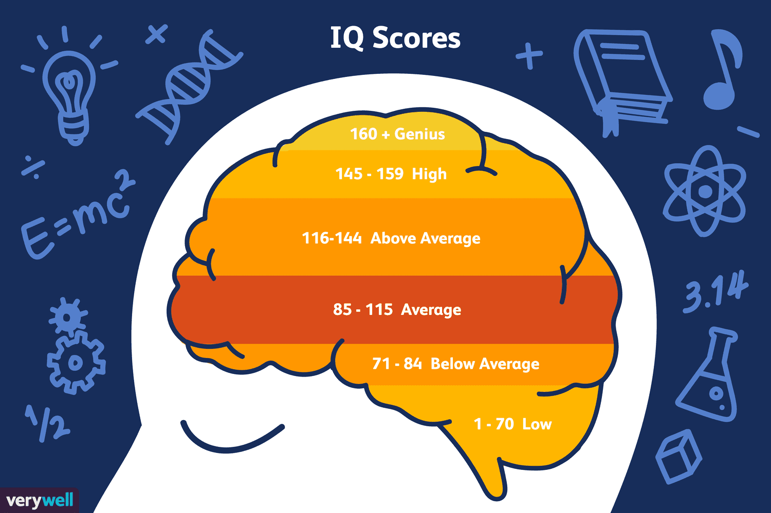
Background
Intelligence Quotient (IQ): a number that expresses the relative intelligence of a person
Research is mixed on the heritability of IQ
Some argue that IQ is trait that is manipulated by environmental factors
Some argue that it is a fixed value determined by an individual’s DNA
Polygenic Risk Prediction (PRS): method of assessing individual’s risk of developing a trait by analyzing genetic variants
Notes:
What Is a Genius IQ Score on an IQ Scale?
Goal of PRS is to maximize r^2 value between a predicted phenotype and the true phenotype

Slide 3
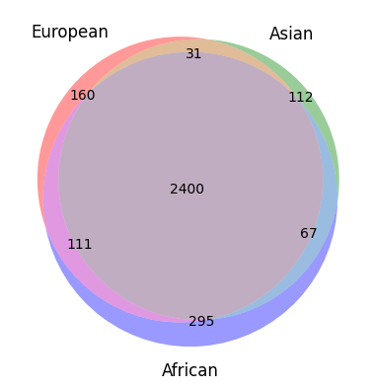
Data
Use HapMap3 SNP data for chromosome 1 for 3 continental populations
European (n = 200): CEU and TSI
Asian (n = 255): CHB, JPT, CHD
African (n = 346): YRI, LWK, MKK
Get summary statistics from single-cell disease relevance score
Notes:
Geographic
Make a point about population size

Slide 4
Methodology Part 1: Data Simulation
Since we have no notion of the phenotypes of the individuals, we must simulate the “true” phenotypes using the genotype and Z-scores from summary statistics
Assume 10% of all SNPs are causal
Perform LD-clumping with PLINK to identify true set of causal SNPs
If SNP is causal, set β* to Z-score, else 0
β = sqrt(h_{g}² = 0.2 / σ²(β*X))β*
Simulate phenotype in the form Y = βX + ɛ where ɛ ~ N(0, 1 - h_{g}²) so σ²(Y) = 1
 | Total Number of SNPs | Number of SNPs into PLINK | Causal SNPs after LD-Clumping
European | 48,708 | 4,870 | 2,702
Asian | 48,708 | 4,870 | 2,610
African | 48,708 | 4,870 | 2,873
Notes:
Go back to previous slide and mention that it might be interesting to look at why certain SNPs have overlap and others dont
Mean of Y is 0 and variance is 1
Variance of (normalized B) * X is 0.2

Slide 5
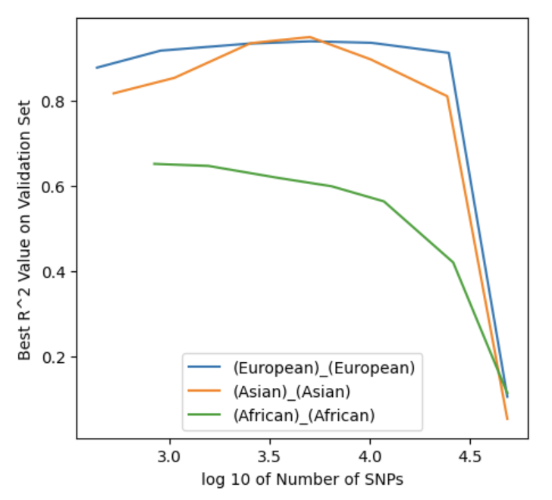
Methodology Part 2: Risk Prediction
Split data for a specific genotype, phenotype pair into Training, Validation and Testing
For each p-value threshold, identify set of SNPs using Armitage trend test value for the model
Perform 5 fold cross validation to identify best model from training data and validating on validation data
Get R^2 value on the testing data
Notes:
Note that R^2 value decreases as we use all SNPs since not all SNPs are causal

Slide 6
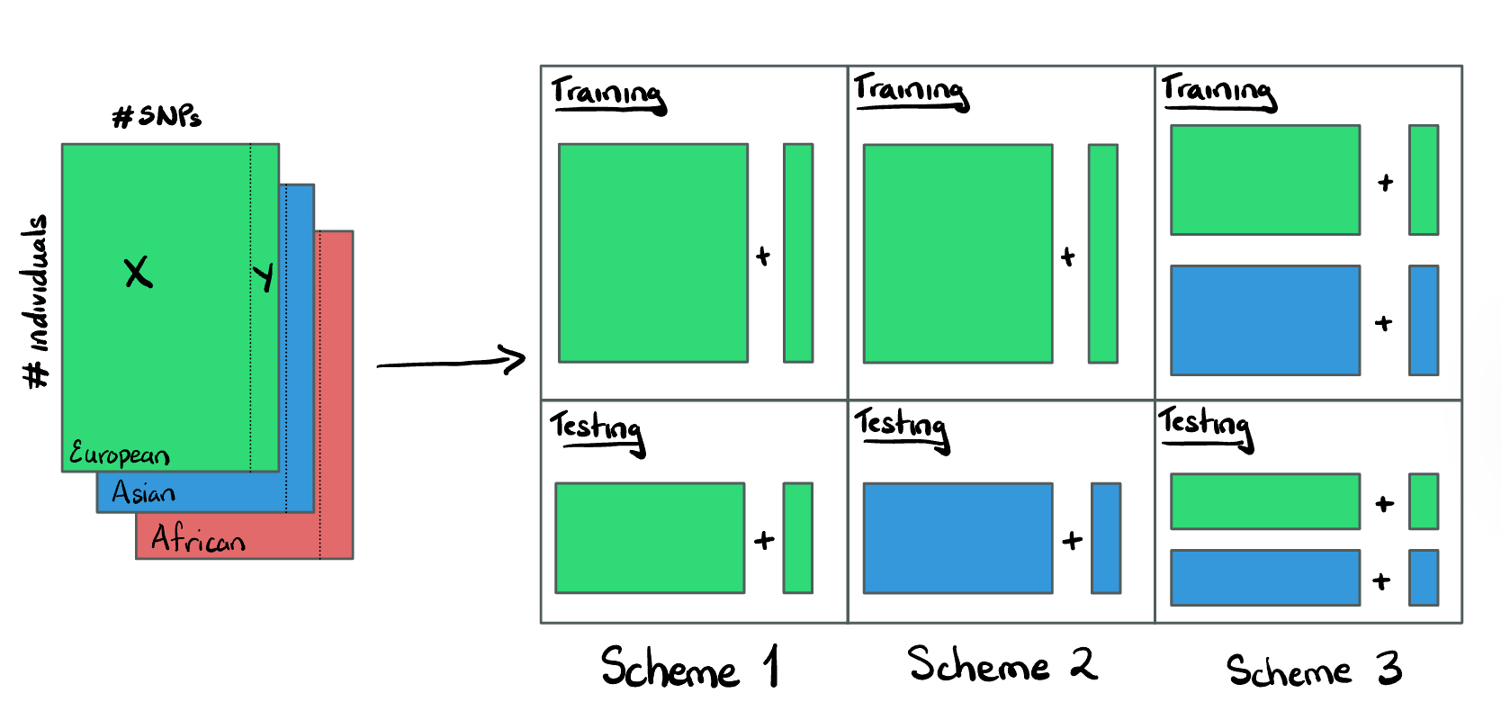
Evaluation of Model
Notes:
We used 3 various training and testing schemes to evaluate our model and 3 main questions:
1) How does PRS change when train and test on same pop?
2) How does PRS change when train on one pop and test on other pop?
3) How does PRS change when train on mixed pop and tested on single and mixed pops?

Slide 7
Results from Scheme 1
 | Testing Set
 |  | European | Asian | African
 | European | 0.0103
 | Asian |  | 0.0006
 | African |  |  | 0.0447
Training Set
Notes:
First scheme, African pop did “best”

Slide 8
Results from Scheme 2
 | Testing Set
 |  | European | Asian | African
 | European |  | 0.0009 | 3.09e-5
 | Asian | 0.0205 |  | 0.0060
 | African | 0.0303 | 0.0081
Training Set
Notes:
Second scheme, training on African and asian did better than european. Note this isn’t really expected, but could be due to sample size differences (asian and African much bigger)
200 european, 255 asian, 346 african

Slide 9
Results from Scheme 3 (and more)
Asian + African performed best on:
European, European + Asian, European + African, Asian + African, European + Asian + African
European + Asian + African performed best on:
African
Notes:
Third scheme: we omitted the table from display due to its size, but best results come from Asian + African mixed on a lot of the pops. We see the full dataset mixed pop perform best on African pop
Discuss the relation between the actual value numbers

Slide 10
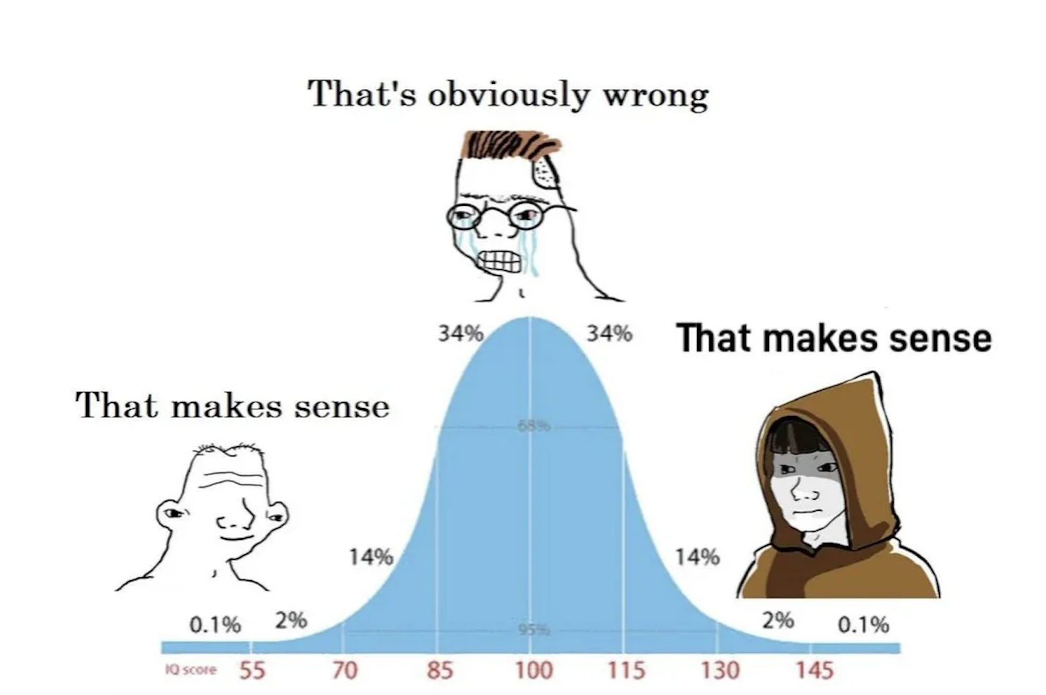
Discussion + Further Work
Mixed populations training > single population training
PRS values all less heritability = 0.2
External factors can strongly affect IQ, like environment
Modify LD-pruning + heritability
Top 60% were kept for causal effect sizes
Need more population specific samples
Notes:
Mixed populations give more statistical power, instead of roughly 100 samples per single pop, we could double our population size. But we lose a lot of the distinctual genetic info
PRS was much less than our fixed heritability of 0.2
We’ll talk about limitations, but other factors do strongly affect IQ, like environment.
Some further avenues: LD-pruning kept 60% of the top 10% causal SNPs on chromosome 1.
Obtaining a larger single population size would have led to us likely picking 3 single populations and working with that

Slide 11
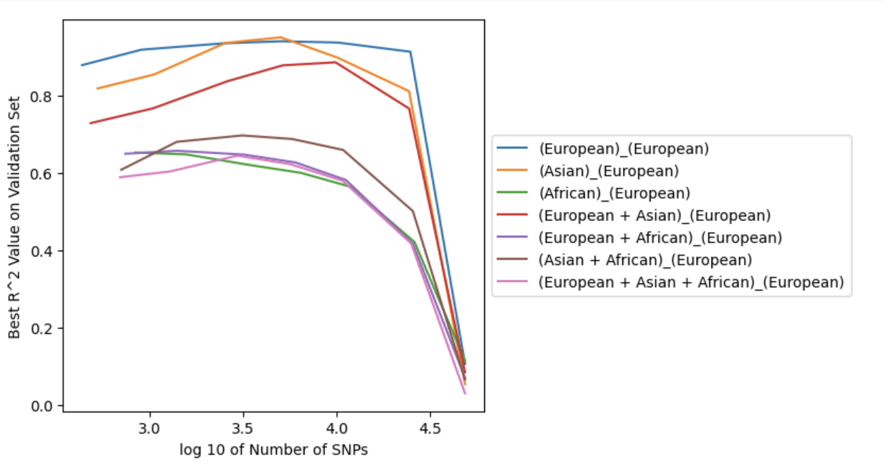
Limitations
Continental populations = agglomeration of nearby populations
Loss of unique population info vs. increased training size
Potential overfitting in training
High r² on thresholded validation sets
Notes:
There were two main limitations to our project. Mentioned before, loss of unique info tradeoff
Overfitting in training process with low number of SNPs, R squared value is very high, means predicted phenotype was really close to true phenotype
Discuss the graph
A way to potentially resolve this would be to have the true phenotypes instead of simulating them ourselves
Nonetheless, this was an interesting investigation into a really exciting field that is extremely beneficial (learning scores/likelihood for traits)

